Slide 1

Real-Time Web-based Auction and Bidding System
CSA4305 – Internet Programming
Presented by:
192411091 POOJASREE B
192471035 AMRITA ANAIKUMAR
192471048 VENNA MEENAKSHI REDDY
192471024 SRIJITHA S
192311363 MATHUSRI P
Supervised By:
Dr. D. Sudhagar

Slide 2



Abstract
A web-based platform that enables users to buy and sell products through online auctions.
Provides secure user registration, authentication, and profile management.
Allows sellers to create, update, and manage auction listings. Supports real-time bidding with automatic highest bid tracking.
Integrates secure payment processing and transaction management.
Includes an admin module for monitoring users, auctions, and generating reports.

Slide 3

Introduction
Online auctions have transformed traditional buying and selling methods.
Enables buyers and sellers to participate from anywhere through the internet.
Eliminates geographical limitations of physical auctions.
Provides transparency through real-time bidding.
Ensures secure transactions and fair winner selection.
Designed for ease of use with an interactive and responsive interface.

Slide 4

Problem Statement
Traditional auctions require physical presence and are time-consuming.
Manual bidding processes are prone to errors and lack transparency.
Difficulty in tracking bids and determining the highest bidder efficiently.
Limited accessibility for buyers and sellers from different locations.
Security concerns in user authentication and payment processing.
Lack of centralized management for auction records and reports.

Slide 5
Existing System Drawbacks
Requires manual auction management.
Limited participation due to geographical restrictions.
Slow communication between buyers and sellers.
No real-time bid updates.
Higher chances of human errors in bid recording.
Limited security for transactions.
Difficult to maintain auction history and reports.
Poor scalability for handling multiple auctions simultaneously.

Slide 6
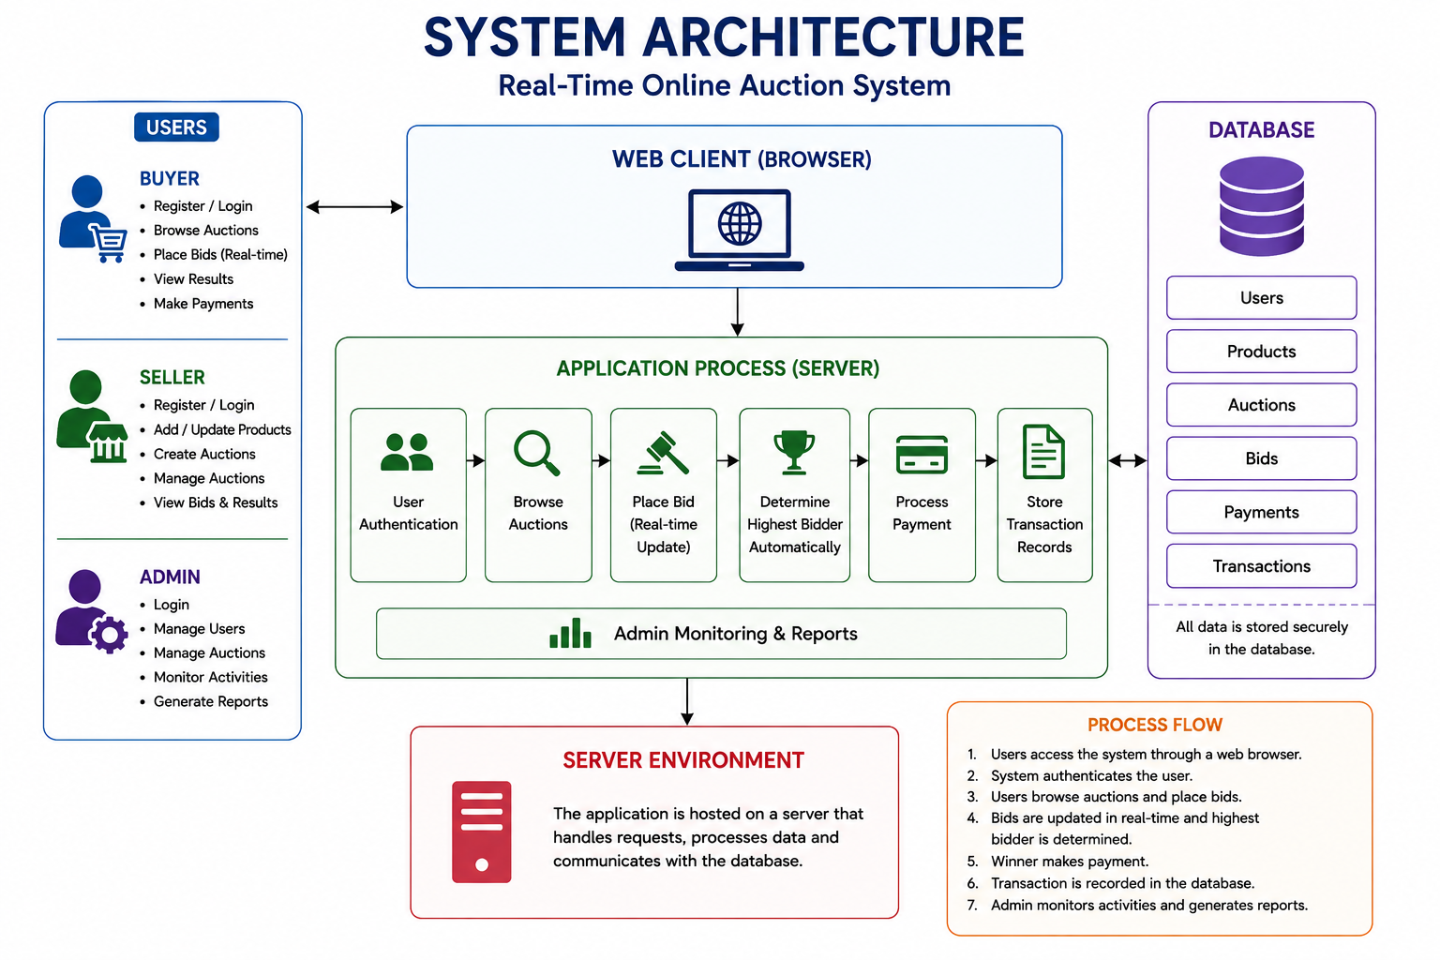
System Architecture

Slide 7
THANK YOU

